Slide 1
FINAL PROJECT
Name : DEEBA M
College : Rohini college of Engineering and Technology
Stream : Computer Science and Engineering
Degree : BE
Email ID : deepadeepa38455@gmail.com
NM ID : au963321104017

Slide 2
PROJECT TITLE:
CREDIT SCORE CLASSIFICATION USING LOGISTIC REGRESSION IN NEURAL NETWORK

Slide 3

AGENDA
The credit score classification project aims to develop a predictive model to assess individuals' creditworthiness based on their financial history and demographic information. Beginning with data collection and exploration, here delve into understanding the nuances of the dataset, followed by preprocessing steps like handling missing values and feature engineering. Then select and train various classification algorithms, evaluating their performance rigorously. The deployment phase involves interpreting model predictions and ensuring fairness. Documentation and reporting encapsulate the journey, highlighting key insights and presenting results in a concise and informative manner.

Slide 4

PROBLEM STATEMENT
The problem statement revolves around developing a robust credit score classification model to assess individual’s creditworthiness accurately. Leveraging historical financial data and demographic information, the objective is to predict credit risk effectively, aiding financial institutions in making informed lending decisions. This project addresses the critical need for reliable credit assessment tools, ensuring fair and equitable access to financial services while mitigating the risk of default.

Slide 5
PROJECT OVERVIEW
Credit scoring is a statistical method which is used to predict the probability that a loan applicant, existing borrower, or counterparty will default or become delinquent.
It provides an estimate of the probability of default or delinquency, which is widely used for consumer lending, credit cards, and mortgage lending.
Credit scoring is used by lenders to decide whether to grant credit or not to borrowers who apply to them.
The goal of any credit scoring process is to be able to summarise all the borrower’s available information into a score.
If a borrower’s score is found to be above a predetermined threshold credit is granted, otherwise it is denied.

Slide 6

WHO ARE THE END USERS?
The end users of the credit score classification model include financial institutions such as banks, credit unions, and lending companies. These entities utilize the model to evaluate the creditworthiness of loan applicants and determine the terms and conditions of lending, including interest rates and loan amounts. Additionally, individuals seeking loans or credit may indirectly benefit from the model as it helps ensure fair and consistent assessment of their credit risk.

Slide 7

YOUR SOLUTION AND ITS VALUE PROPOSITION
Solution: - Utilizing Machine Learning Algorithms to Predict Credit Scores. - Incorporating Data from Credit Bureaus and Lending Institutions. - Employing Advanced Classification Techniques for Accurate Assessment. Value Proposition: - Streamlined Credit Risk Assessment Process. - Improved Decision Making in Lending and Financial Industries. - Enhanced Efficiency and Accuracy in Evaluating Creditworthiness. - Reduction in Default Rates and Financial Losses. - Empowering Individuals and Businesses with Access to Better Financial Opportunities.

Slide 8
THE WOW IN YOUR SOLUTION
The "wow" factor in the solution lies in its ability to accurately predict creditworthiness using advanced machine learning techniques. By leveraging sophisticated algorithms and comprehensive data analysis, the model can effectively identify patterns and signals indicative of credit risk, enabling financial institutions to make more informed lending decisions. This not only enhances the efficiency of the lending process but also contributes to minimizing the risk of default and optimizing loan portfolios. Additionally, the model's interpretability and fairness measures ensure transparency and equity in credit assessment, fostering trust and confidence among both lenders and borrowers. Ultimately, the solution offers a transformative approach to credit scoring, aligning with industry best practices and regulatory standards while driving positive outcomes for all stakeholders involved.

Slide 9
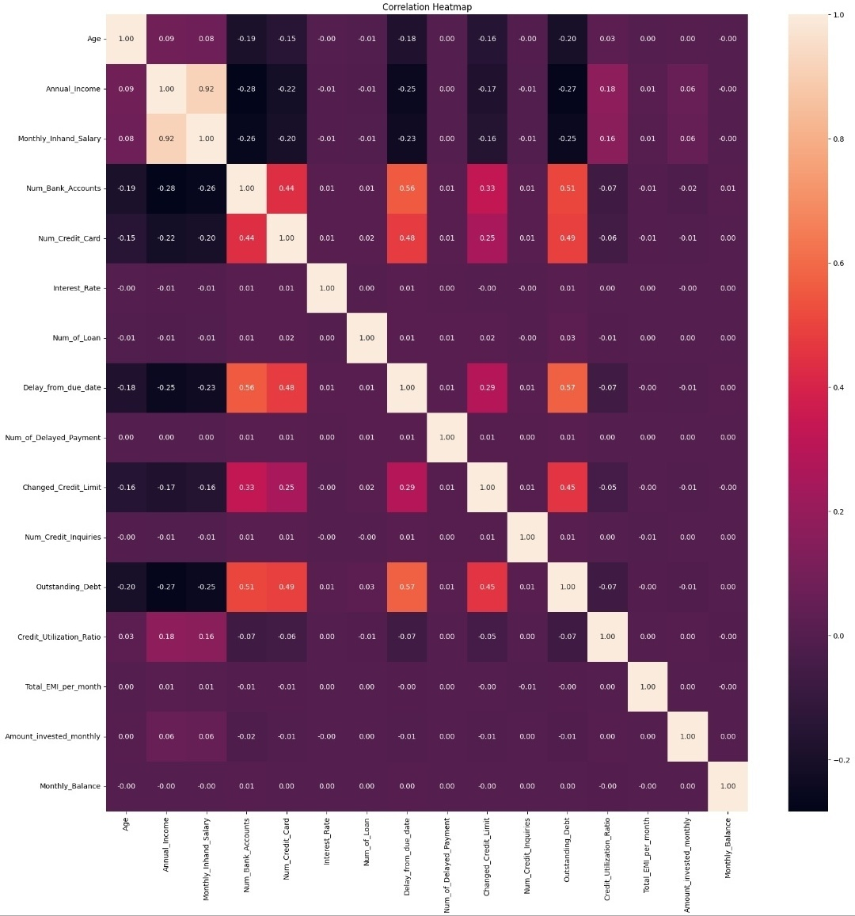
MODELLING
The credit score is an important metric that determines an individual's creditworthiness and ability to obtain loans. Using Logistic Regression model original data, does very well at predicting 'healthy loans' with accuracy, precision and recall close to 100%. It still does well, but performs noticeably worse at identifying high-risk loans where it has a precision of 85% and a recall of 91%. This suggests that this model is less able to classify high risk loans than healthy loans. This is likely related to the skew in the data that was provided, with only about 3 percent of the sample being in the high risk loans category.

Slide 10
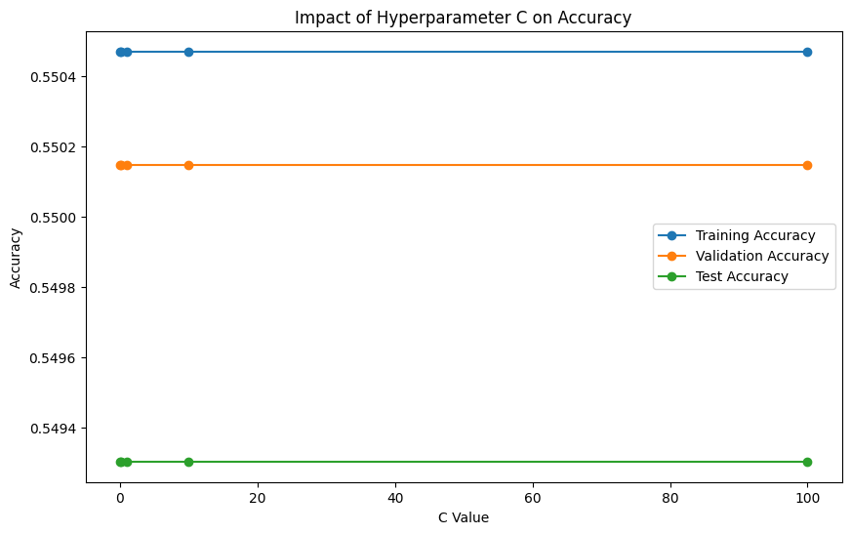
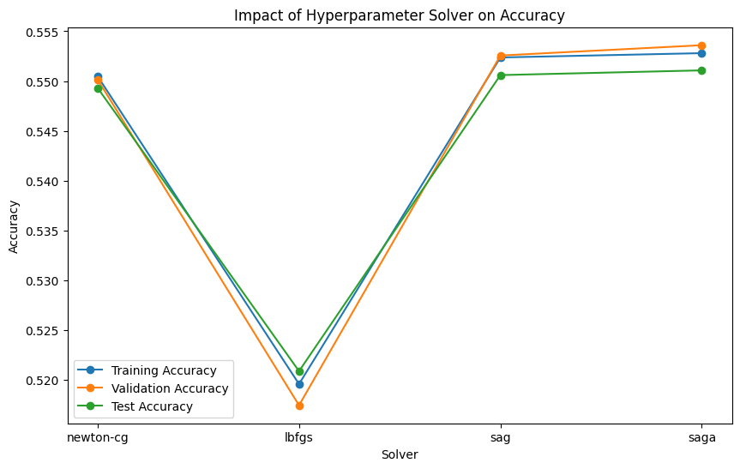
RESULTS Demo link : https://colab.research.google.com/drive/1epCLxYgfcETOxYzpgZYeqTy3nGhPmkNH#scrollTo=-EWd2NuXxKeF

